Slide 1
COSC3503 Operating Systems Chapter 11 File-System Interface
Doug Lim

Slide 2
File Concept
Contiguous logical address space
Types:
Data
numeric
character
binary
Program
Contents defined by file’s creator
Many types
Consider text file, source file, executable file

Slide 3
File Attributes
Name – only information kept in human-readable form
Identifier – unique tag (number) identifies file within file system
Type – needed for systems that support different types
Location – pointer to file location on device
Size – current file size
Protection – controls who can do reading, writing, executing
Time, date, and user identification – data for protection, security, and usage monitoring
Information about files are kept in the directory structure, which is maintained on the disk
Many variations, including extended file attributes such as file checksum
Information kept in the directory structure

Slide 4
File Operations
File is an abstract data type
Create
Write – at write pointer location
Read – at read pointer location
Reposition within file - seek
Delete
Truncate
Open(Fi) – search the directory structure on disk for entry Fi, and move the content of entry to memory
Close (Fi) – move the content of entry Fi in memory to directory structure on disk

Slide 5
Open Files
Several pieces of data are needed to manage open files:
Open-file table: tracks open files
File pointer: pointer to last read/write location, per process that has the file open
File-open count: counter of number of times a file is open – to allow removal of data from open-file table when last processes closes it
Disk location of the file: cache of data access information
Access rights: per-process access mode information

Slide 6
Open File Locking
Provided by some operating systems and file systems
Similar to reader-writer locks
Shared lock similar to reader lock – several processes can acquire concurrently
Exclusive lock similar to writer lock
Mediates access to a file
Mandatory or advisory:
Mandatory – access is denied depending on locks held and requested
Advisory – processes can find status of locks and decide what to do

Slide 7
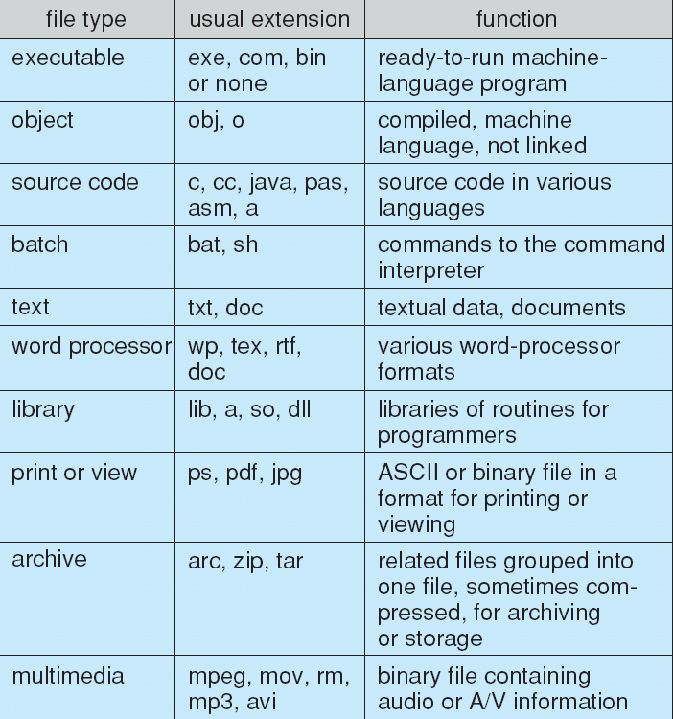
File Types – Name, Extension

Slide 8
File Structure
None - sequence of words, bytes
Simple record structure
Lines
Fixed length
Variable length
Complex Structures
Formatted document
Relocatable load file
Can simulate last two with first method by inserting appropriate control characters
Who decides:
Operating system
Program

Slide 9
Access Methods
Sequential Access
read next
write next
reset
no read after last write
(rewrite)
Direct Access – file is fixed length logical records
read n
write n
position to n
read next
write next
rewrite n
n = relative block number
Relative block numbers allow OS to decide where file should be placed

Slide 10
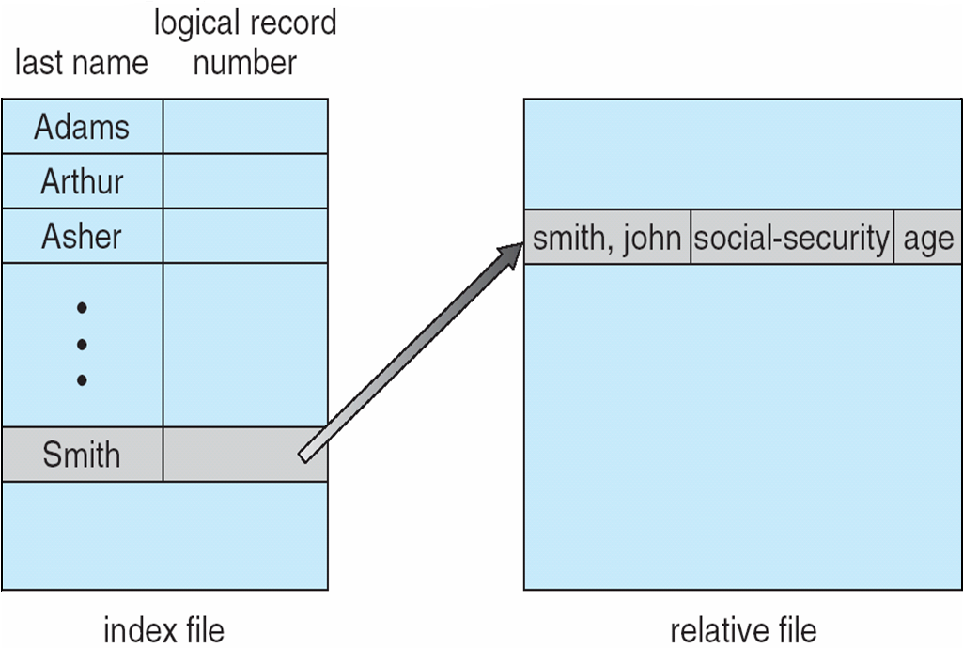
Other Access Methods
Can be built on top of base methods
General involve creation of an index for the file
Keep index in memory for fast determination of location of data to be operated on (consider UPC code plus record of data about that item)
If too large, index (in memory) of the index (on disk)
IBM indexed sequential-access method (ISAM)
Small master index, points to disk blocks of secondary index
File kept sorted on a defined key
All done by the OS
VMS operating system provides index and relative files as another example

Slide 11
Directory Structure
A collection of nodes containing information about all files
Directory
Files
F 1
F 2
F 3
F 4
F n

Slide 12
Types of File Systems
We mostly talk of general-purpose file systems
But systems frequently have may file systems, some general- and some special- purpose
Consider Solaris has
tmpfs – memory-based volatile FS for fast, temporary I/O
objfs – interface into kernel memory to get kernel symbols for debugging
ctfs – contract file system for managing daemons
lofs – loopback file system allows one FS to be accessed in place of another
procfs – kernel interface to process structures
ufs, zfs – general purpose file systems

Slide 13
Operations Performed on Directory
Search for a file
Create a file
Delete a file
List a directory
Rename a file
Traverse the file system

Slide 14
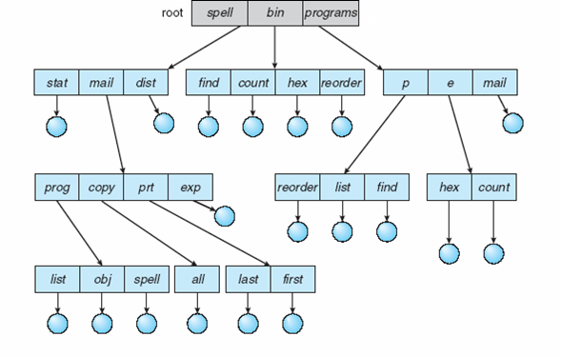
Directory Structures
Single-Level Directory
Two-Level Directory
Tree-Structured Directories

Slide 15
Directory Structures
Single-Level Directory
Two-Level Directory
Tree-Structured Directories

Slide 16
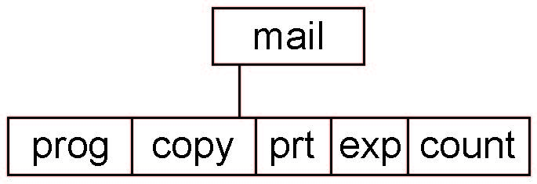
Tree-Structured Directories
Absolute or relative path name
Creating a new file is done in current directory
Delete a file
rm <file-name>
Creating a new subdirectory is done in current directory
mkdir <dir-name>
Example: if in current directory /mail
mkdir count
Deleting “mail” ⇒ deleting the entire subtree rooted by “mail”

Slide 17
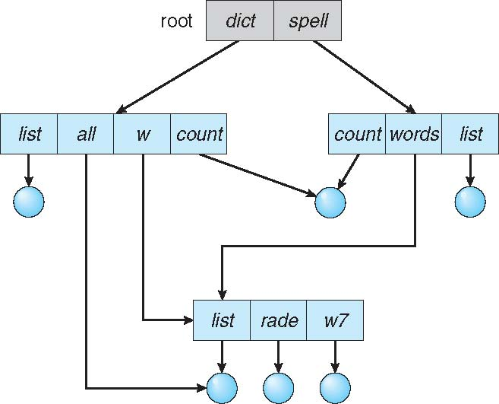
Acyclic-Graph Directories
Have shared subdirectories and files
Two different names (aliasing)
If dict deletes list ⇒ dangling pointer
Solutions:
Backpointers, so we can delete all pointers Variable size records a problem
Backpointers using a daisy chain organization
Entry-hold-count solution
New directory entry type
Link – another name (pointer) to an existing file
Resolve the link – follow pointer to locate the file

Slide 18
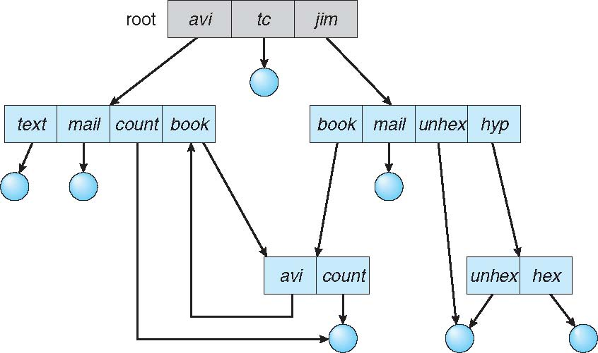
General Graph Directory
How do we guarantee no cycles?
Allow only links to file not subdirectories
Garbage collection
Every time a new link is added use a cycle detection algorithm to determine whether it is OK

Slide 19
File System Mounting
A file system must be mounted before it can be accessed
An unmounted file system is mounted at a mount point

Slide 20
File Sharing
Sharing of files on multi-user systems is desirable
Sharing may be done through a protection scheme
On distributed systems, files may be shared across a network
Network File System (NFS) is a common distributed file-sharing method
If multi-user system
User IDs identify users, allowing permissions and protections to be per-user Group IDs allow users to be in groups, permitting group access rights
Owner of a file / directory
Group of a file / directory

Slide 21
File Sharing – Failure Modes
All file systems have failure modes
For example corruption of directory structures or other non-user data, called metadata
Remote file systems add new failure modes, due to network failure, server failure
Recovery from failure can involve state information about status of each remote request
Stateless protocols such as NFS v3 include all information in each request, allowing easy recovery but less security

Slide 22
Protection
File owner/creator should be able to control:
what can be done
by whom
Types of access
Read
Write
Execute
Append
Delete
List

Slide 23
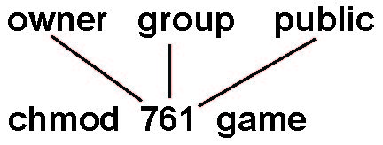
Access Lists and Groups
Mode of access: read, write, execute
Three classes of users on Unix / Linux
RWX
a) owner access 7 ⇒ 1 1 1 RWX
b) group access 6 ⇒ 1 1 0
RWX
c) public access 1 ⇒ 0 0 1
Ask manager to create a group (unique name), say G, and add some users to the group.
For a particular file (say game) or subdirectory, define an appropriate access.
Attach a group to a file chgrp G game

Slide 24
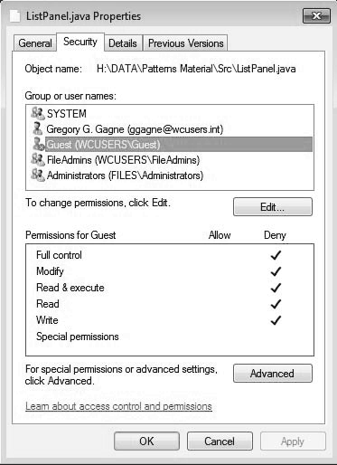
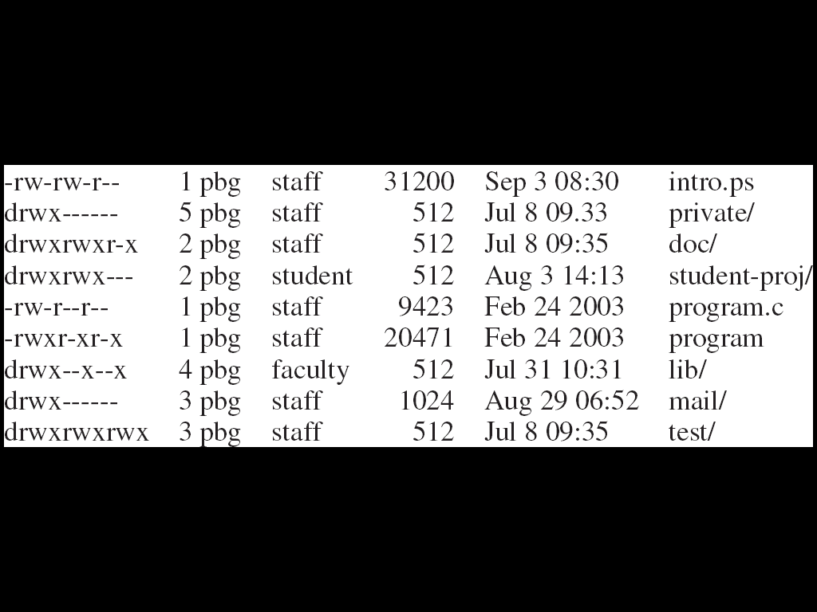
Windows 7 Access-Control List Management
Unix Directory Listing

